Slide 1
Deciphering Earth’s Surface - Land Cover Prediction via
Computer Vision on Satellite Imagery
UMBC Data Science Master Degree Capstone
Under the guidance by
Dr. Tony Diana
A Project by:
Akash Reddy Loka - LB04019
Yashwanth Vemulapalli - PP24297
GitHub Profile: https://github.com/akashloka

Slide 2
Introduction
In this technological era, technology can be leveraged in environmental science to give us amazing chances to understand and manage our planet resources. One such area is use of satellite image data for environmental surveillance wherein careful watch is kept for tracking changes, assessing impacts, and ensuring well-being of ecosystems and communities.
The information collected through environmental surveillance serves to identify potential risks, guide decision-making processes, and support initiatives aimed at preserving and safeguarding natural resources.
The environmental surveillance can be achieved by training and deploying the CNN architecture model.

Slide 3
Business Problem Statement
In today's rapidly evolving world, effective environmental monitoring, disaster response, and urban planning are essential for sustainable development and the well-being of communities.
To address this challenge, there is a critical need for an automated image recognition system capable of accurately predicting land cover in satellite imagery.
Such a system would enable continuous monitoring of environmental changes, timely disaster response, and informed urban planning.
The successful implementation of this solution will not only contribute to addressing pressing societal challenges but also offer opportunities for partnerships with governmental agencies, environmental organizations, and urban planners seeking innovative technology solutions.

Slide 4
Research Questions
How can deep learning architectures like Convolution Neural Networks (CNNs) be adapted to handle satellite imagery data?
How can transfer learning techniques be utilized to leverage pre-trained deep learning models for land cover prediction in satellite imagery?
How does the data augmentation beneficial for enhancing the performance of the image recognition model?
How do pre-trained architectures (For example VGG19, VGG16, Xception etc.,) compare in terms of land cover prediction accuracy on satellite imagery dataset?

Slide 5
Dataset
The dataset was created by the Remote Sensing Technology institute of the German Aerospace Centre.
There are total of 27000 images distributed among 10 classes. Each image in the dataset had 13 spectral bands.
The size of the dataset is 2.7 GB.
Link to download - https://madm.dfki.de/files/sentinel/EuroSATallBands.zip

Slide 6
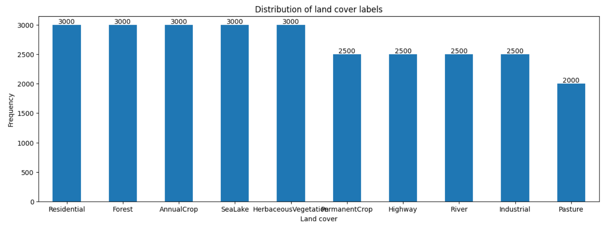
Exploratory Data Analysis
From the plot it can be observed that the Pasture image label has least number of images in dataset and whereas the below mentioned labels has the highest number of images.
Herbaceous Vegetation
Forest
Sealake
Annual Crop
Residential
Fig 1 – Distribution of class labels

Slide 7
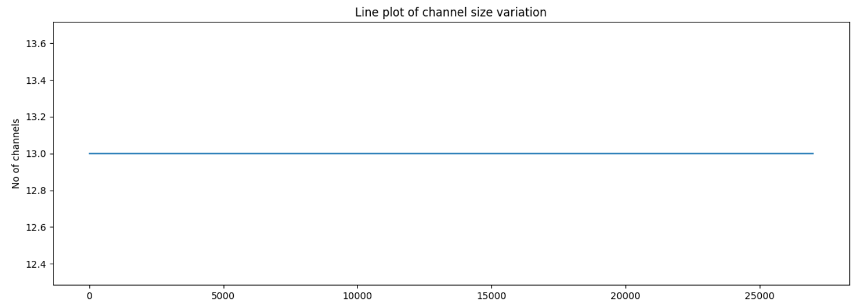
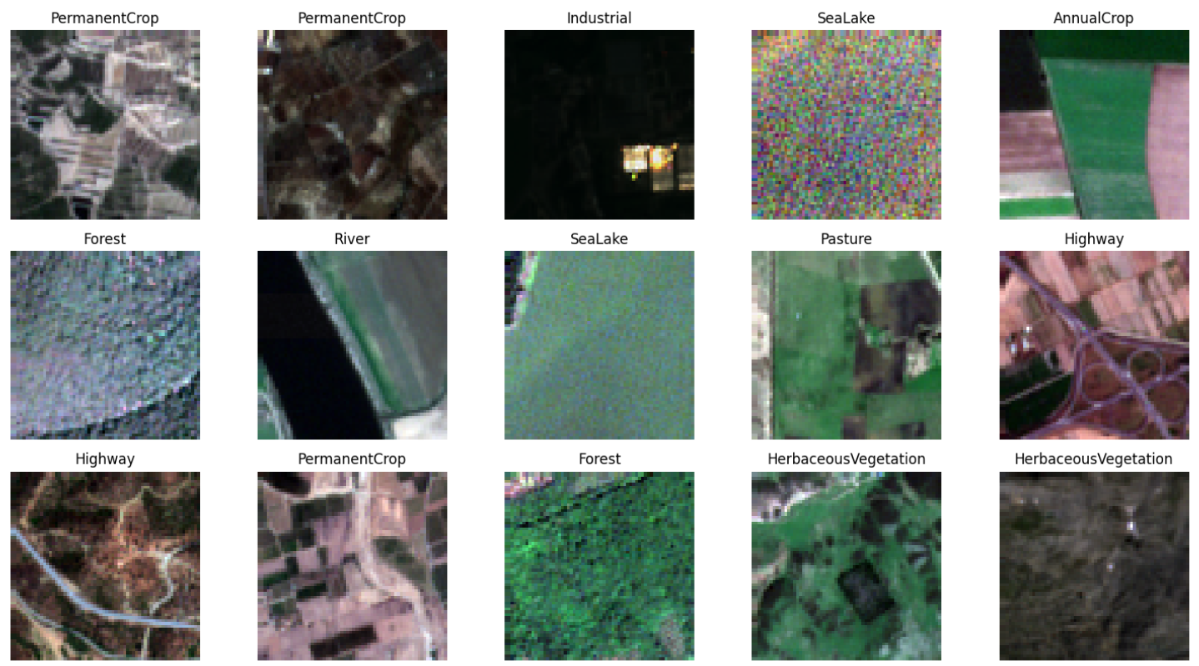
From the above line chart, it can be observed that there are same number of channels for all the images in the dataset which are 13.
Fig 2 - Sample images from the dataset.

Slide 8
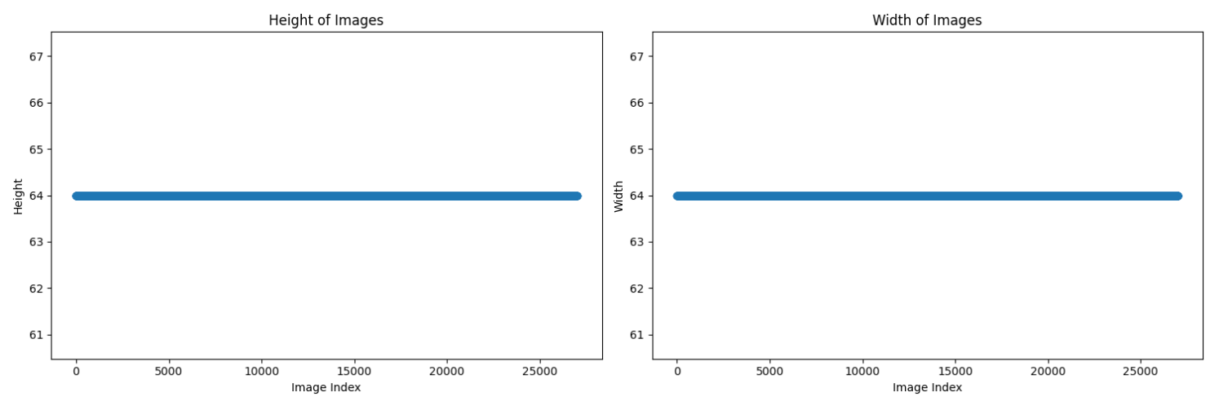
Fig 3 – Line chart for heights and widths of images
From the above line charts for image heights and widths, it can be observed that the heights and widths of all images are found to be 64 and 64 respectively.

Slide 9
Methodology
For building this image recognition system, the following methodology has been employed.
Download the dataset from the source.
Explore the image data.
Create a custom data generator and process .tiff image files using tifffile library.
Create a CNN model and use pre-trained CNN models (VGG16, VGG19, Xception).
Train the model.
Deploy the web app created using Streamlit in NGROK.

Slide 10
Results
The following are the training results obtained for each model for the following conditions.
Optimizer – Adam @ initial learning rate of 0.0001
Total number of epochs – 60.
Early stopping – Training stops early if the categorical accuracy does not change for 4 consecutive iterations.
Learning rate – Reduces learning rate by 0.95 if the categorical accuracy does not change for 2 consecutive iterations.
Model | Params | Train Loss | Test Loss | Train Accuracy | Test Accuracy
Custom CNN model | 114394 | 0.1567 | 0.1438 | 0. 946 | 0. 9515
VGG19 | 20551852 | 0. 1086 | 0. 1051 | 0. 9647 | 0.9713
VGG16 | 15242156 | 0. 1067 | 0. 0961 | 0. 9651 | 0. 9689
Xception | 22907284 | 0. 1122 | 0. 2156 | 0. 9614 | 0.9607

Slide 11
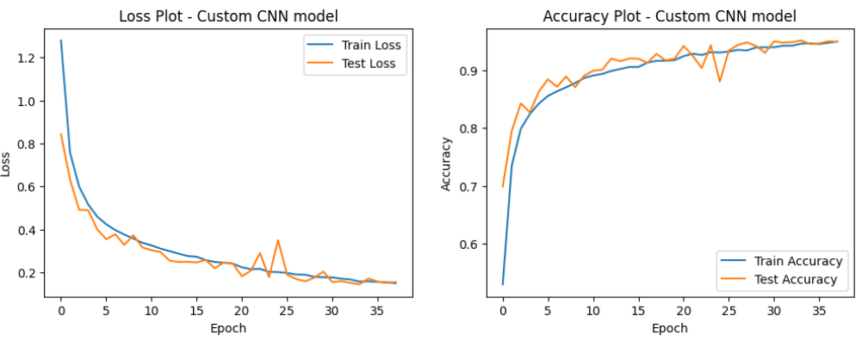
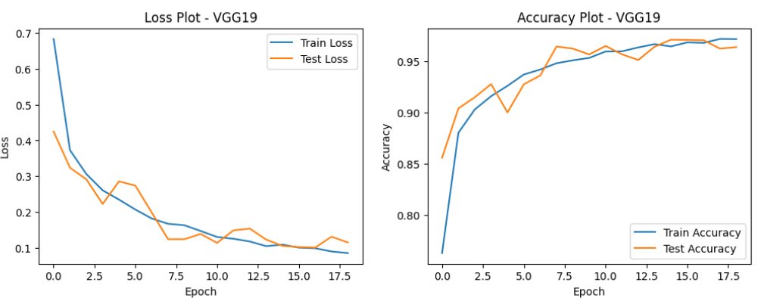
Fig 4 – Loss and Accuracy plot for CNN Model
Fig 5 – Loss and Accuracy plot for VGG19 Model

Slide 12
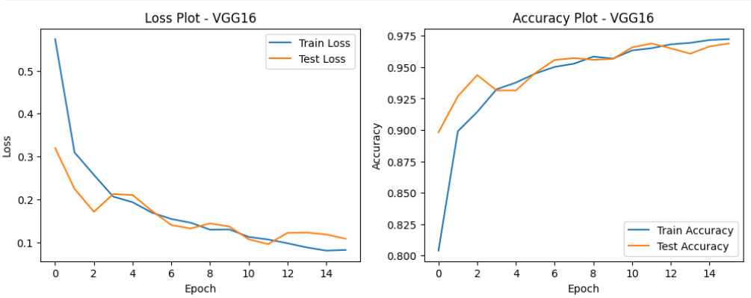
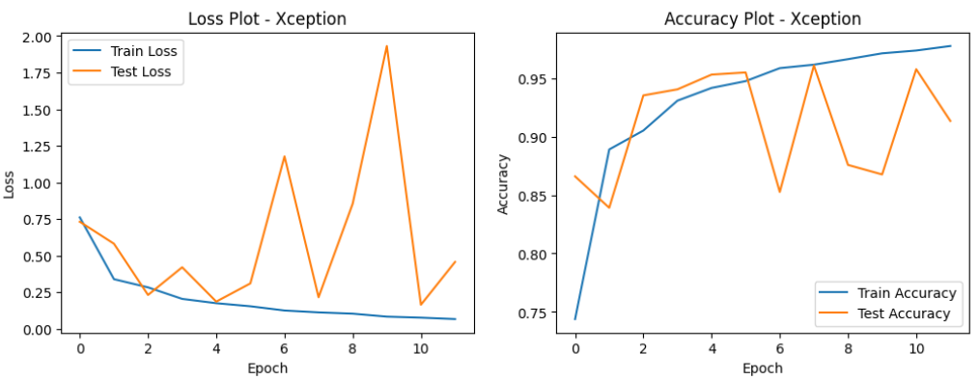
Fig 6 – Loss and Accuracy plot for VGG16 Model
Fig 7 – Loss and Accuracy plot for Xception Model
It can be observed from the above results that VGG19 model performed better than any other model considering highest test accuracy. It can be considered as the best model for predictions.

Slide 13
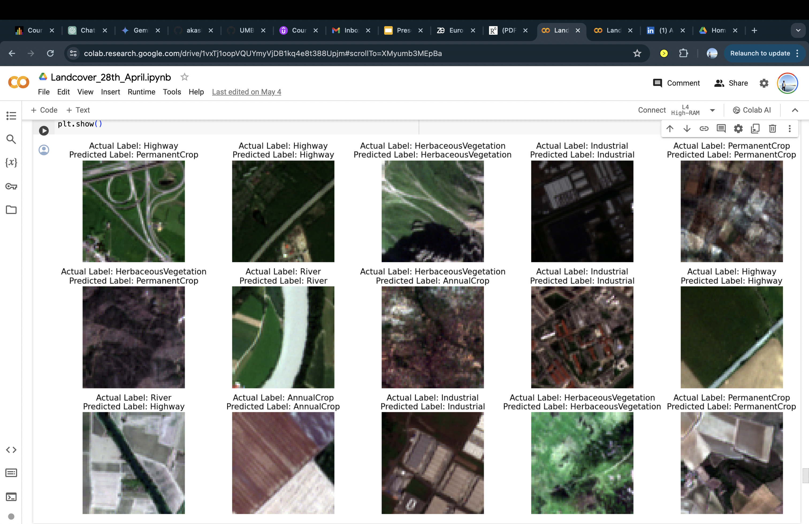
Predictions on Sample test data

Slide 14
Web Application
The image recognition application has been built using Streamlit considering its built-in web server which eliminates the need for setting up separate server infrastructure.
Applications can be run locally or deployed to production with a single command streamlining the deployment process.
Ngrok tool has been used to share and test application. It is a tool that creates secure tunnels to localhost allowing us to expose local web servers to the internet using a secure public URL.

Slide 15
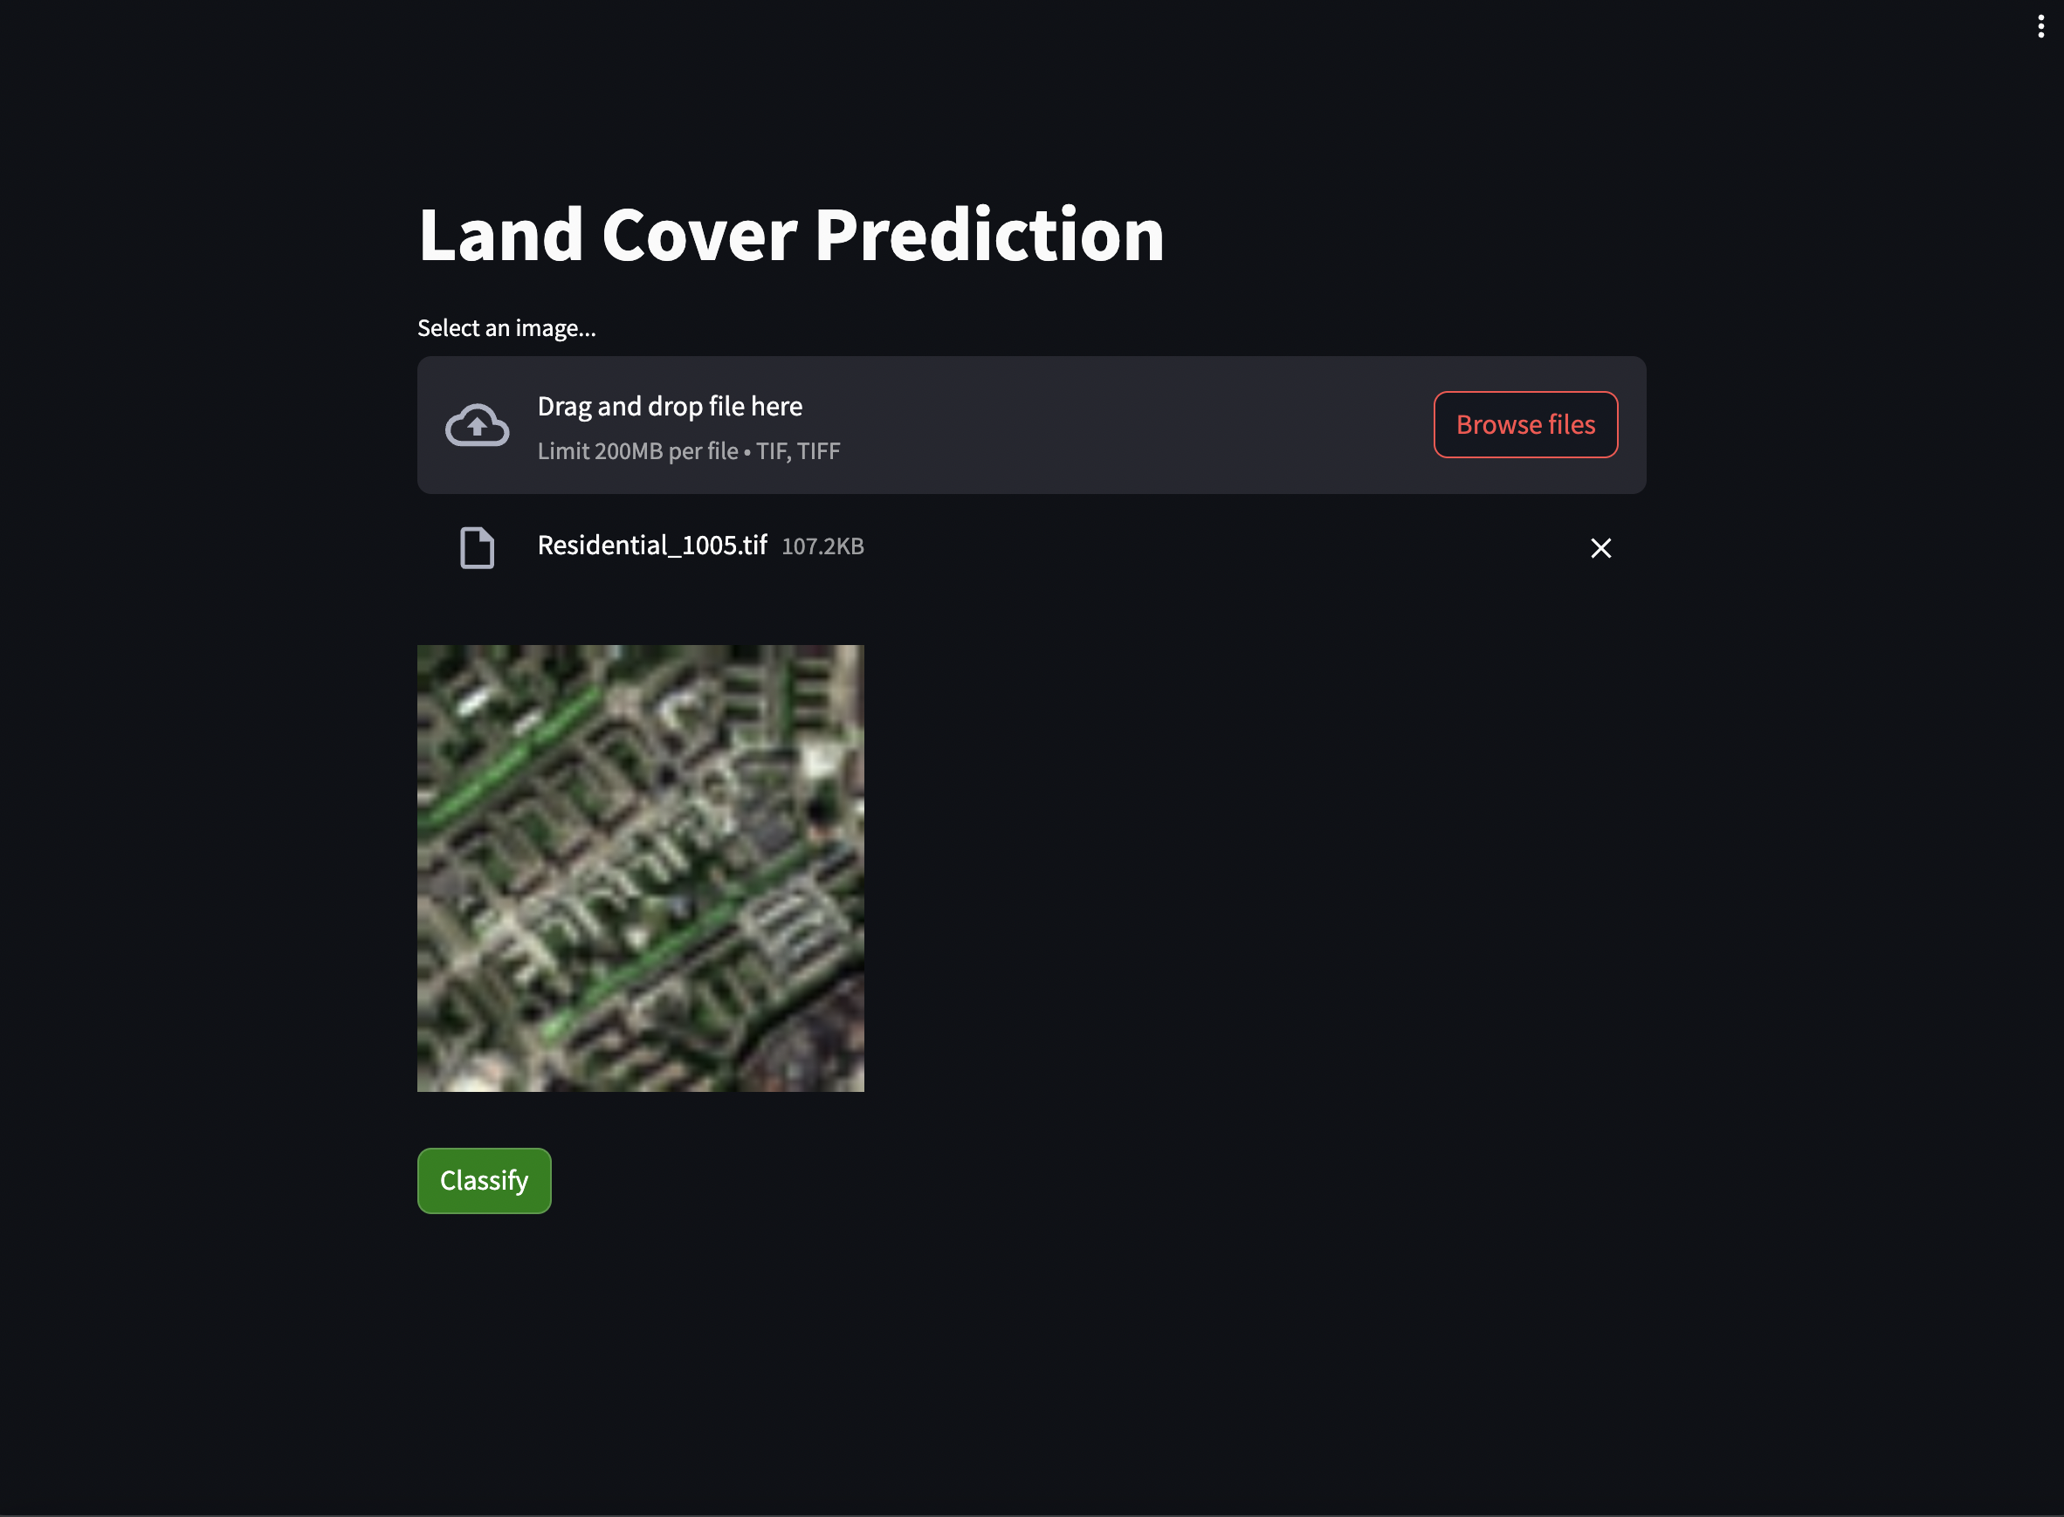
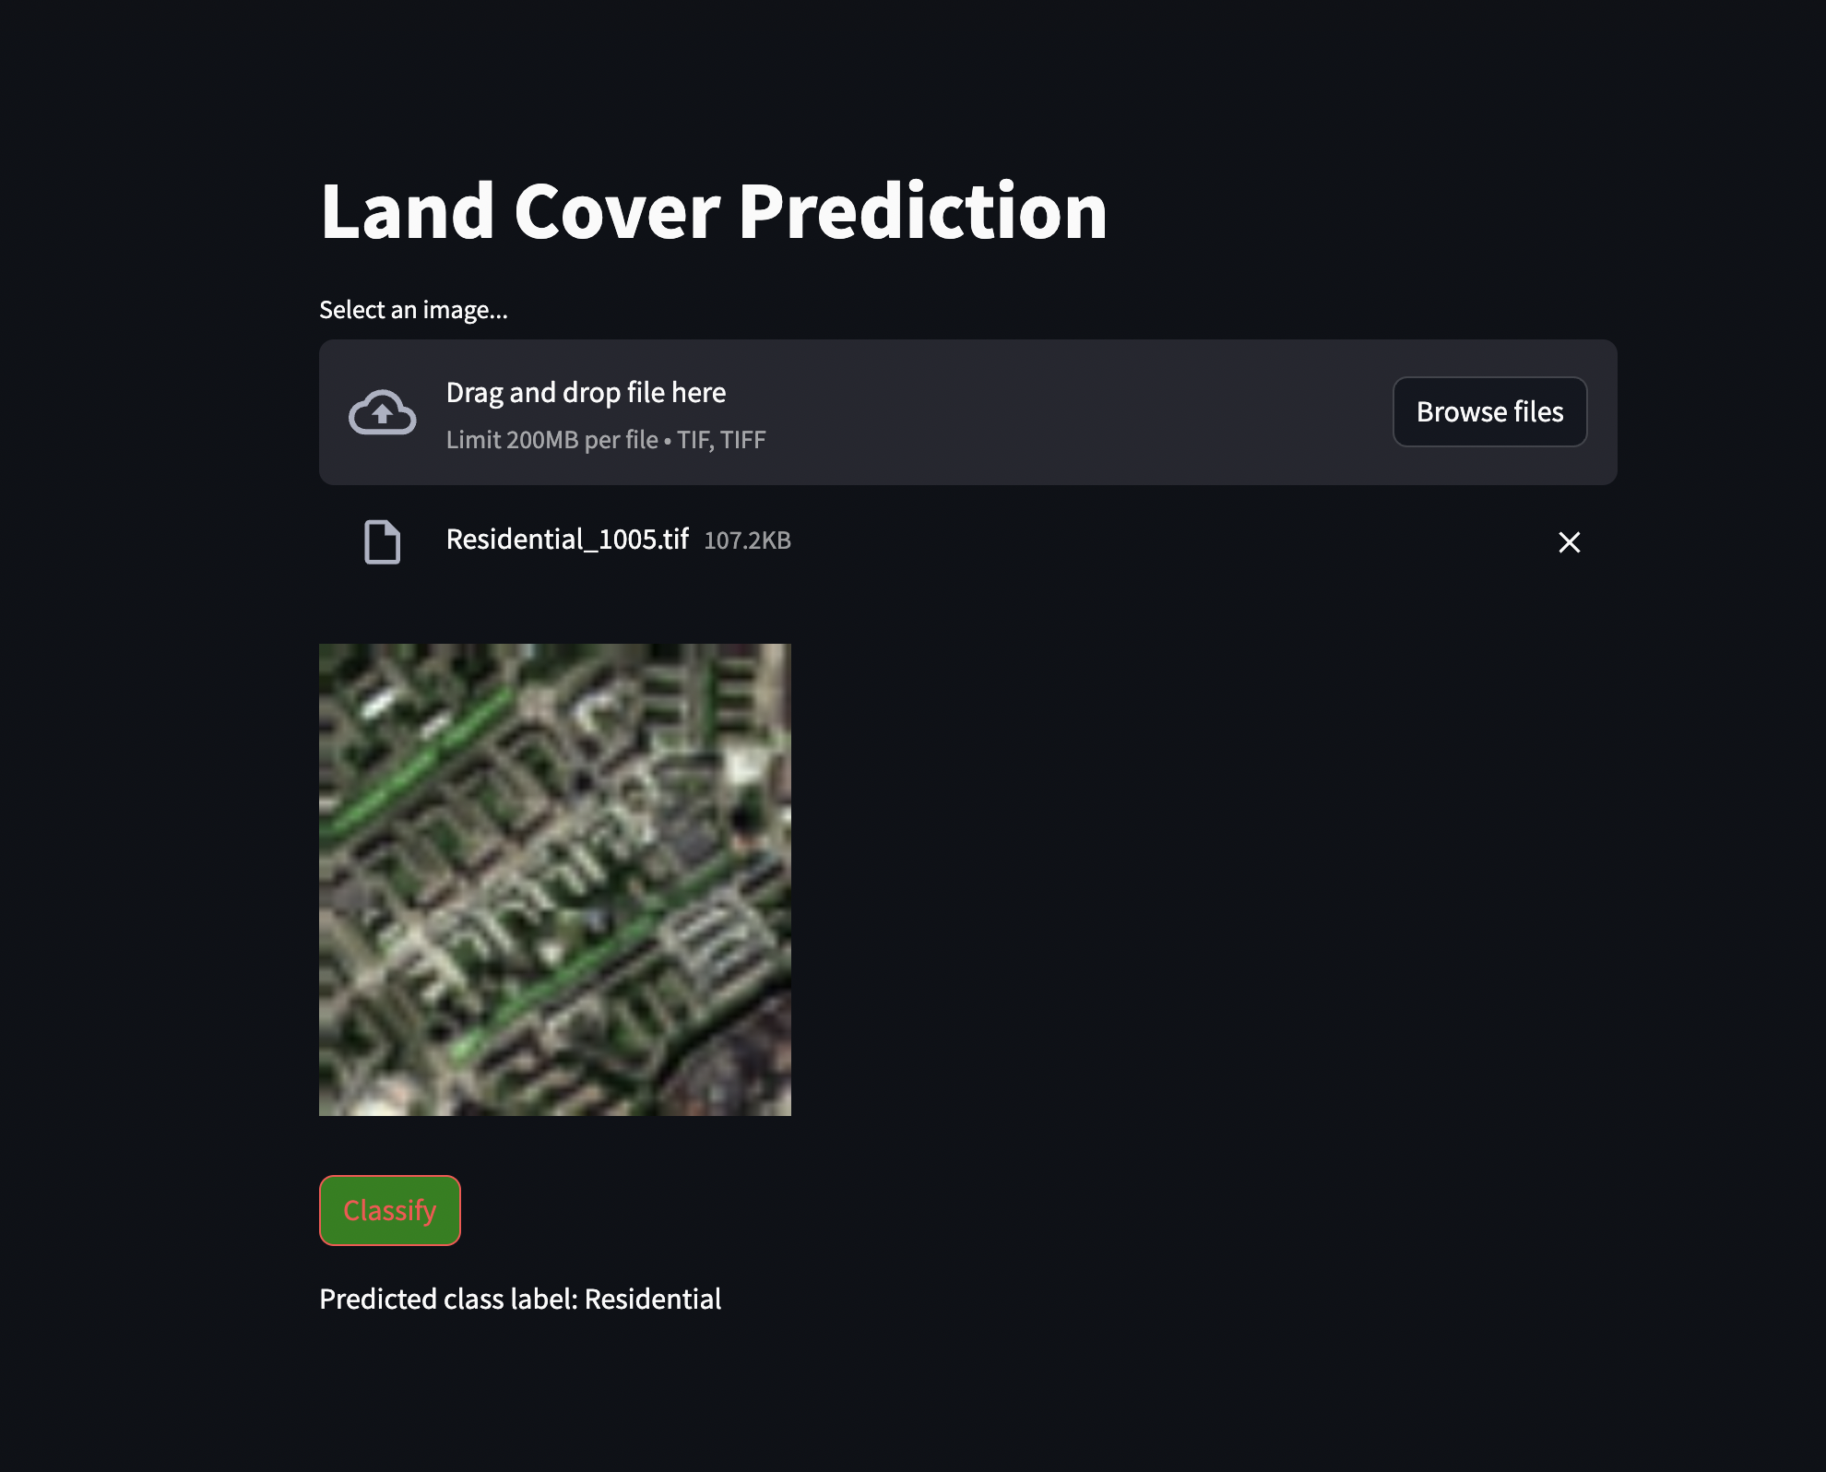
Web Application

Slide 16
Conclusion
Custom CNN model: 114,394 parameters, train accuracy: 94.6%, test accuracy: 95.15%.
VGG19: 20,551,852 parameters, test accuracy: 97.13%.
VGG16: 15,242,156 parameters, test accuracy: 96.89%.
Xception: 22,907,284 parameters, test accuracy: 96.07%.
Conclusion: VGG19 and VGG16 outperform Custom CNN and Xception, offering higher accuracy and lower loss values for land cover image classification.

Slide 17
Limitations
Since the study is conducted using very few landcover types, the model might not generalize well for the unknown landcovers.
Achieving low latency with label prediction using image recognition system might be another limitation here. Since, loading the CNN model with millions of parameters could take considerable time, there could be delay in the initiation of the request and the receipt of the response.

Slide 18
Future Work
The project could very well be studied with huge data provided that we have good computation power so that model could perform well for all types of landcovers.
We can study to reduce the latency of the image recognition system by optimizing the model architecture and computation resources.

Slide 19
References
Helber, P., Bischke, B., Dengel, A., & Borth, D. (2019). Eurosat: A novel dataset and deep learning benchmark for land use and land cover classification. IEEE Journal of Selected Topics in Applied Earth Observations and Remote Sensing, 12(7), 2217-2226.
Link - https://ieeexplore.ieee.org/abstract/document/8736785
Senecal, J. J., Sheppard, J. W., & Shaw, J. A. (2019, July). Efficient convolutional neural networks for multi-spectral image classification. In 2019 International Joint Conference on Neural Networks (IJCNN) (pp. 1-8). IEEE.
Link - https://ieeexplore.ieee.org/abstract/document/8851840
Shaha, M., & Pawar, M. (2018, March). Transfer learning for image classification. In 2018 second international conference on electronics, communication and aerospace technology (ICECA) (pp. 656-660). IEEE.
Link - https://ieeexplore.ieee.org/document/8474802

Slide 20
THANK YOU

